Slide 1

CO² EMISSION IN RWANDA
main · Streamlit (co2-emissions-in-rwanda.streamlit.app)
PRACTICAL MACHINE LEARNING COURSE
CONTRIBUTORS:
1. Peter Utomakili
2. Sameer Ahamed
3. Adejoke Adeoye

Slide 2
main · Streamlit (co2-emissions-in-rwanda.streamlit.app)
CONTENT
CONCLUSION
04
METHODOLOGY
1.PRELIMINARY ANALYSIS
2. DATA CLEANING AND PREPARATION.
02
05
CONTINUED RESEARCH
MODEL EVALUATION
03
1. MODEL COMPARISON.
2. MODEL TESTING.
1. FUTURE WORKS.
PROJECT OVERVIEW
1. OBJECTIVES.
2. PROJECT BENEFITS
01

Slide 3
PROJECT OVERVIEW
main · Streamlit (co2-emissions-in-rwanda.streamlit.app)
AIMS AND OBJECTIVES

Slide 4
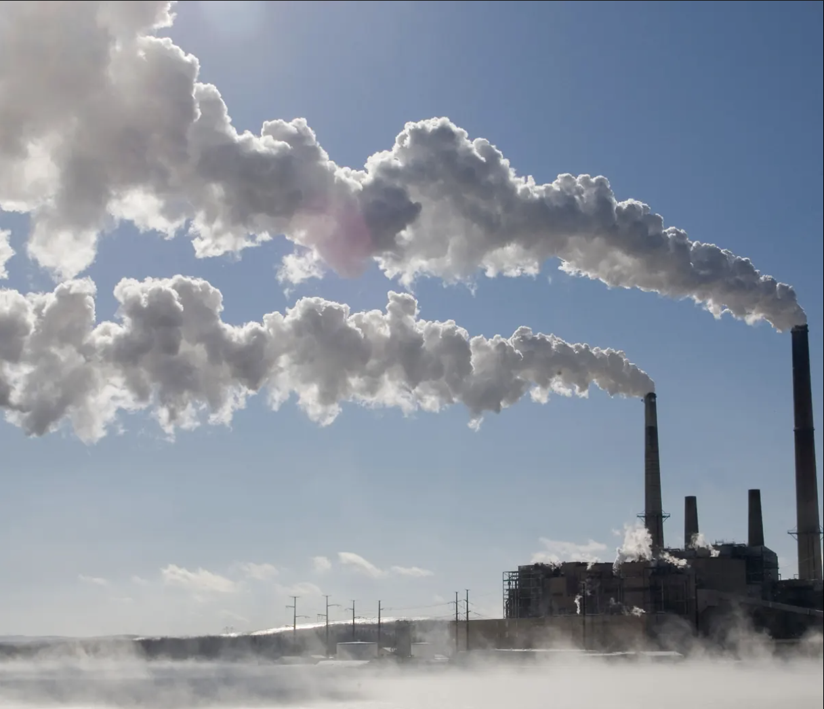
Project Overview
main · Streamlit (co2-emissions-in-rwanda.streamlit.app)
Our primary focus is on greenhouse gas emissions, particularly carbon dioxide (CO2). These emissions result from a variety of human activities, including the use of fossil fuels for energy, transportation, manufacturing, and deforestation. Rising global temperatures, more frequent and severe extreme weather events, the melting of the polar ice caps, an increase in sea level, and disruptions to ecosystems and biodiversity are some of the negative repercussions that follow. To ensure a healthy and habitable planet for both the present and future generations, addressing the emissions problem is a global necessity that requires cooperative efforts to reduce and ultimately eradicate these harmful emissions.

Slide 5

main · Streamlit (co2-emissions-in-rwanda.streamlit.app)
Project Significance
There are various reasons why using a regression model to forecast CO2 emissions is important. Firstly, it is an effective means in the struggle against climate change on a worldwide scale. Researchers and policymakers can decide how to mitigate the environmental impact of CO2 emissions in Rwanda by better understanding the elements that drive these emissions. Secondly, there isn’t quality data that we can get from the subcontinent. Therefore, we can use the predictive model from Rwanda as a generalisation to all of Africa. It equips decision-makers to develop efficient policies and allocate resources to lower emissions and attain sustainability development goals.

Slide 6
METHODOLOGY
main · Streamlit (co2-emissions-in-rwanda.streamlit.app)
EXPLORATORY DATA ANALYSIS

Slide 7
Preliminary Feature Analysis
main · Streamlit (co2-emissions-in-rwanda.streamlit.app)
The factors we’ve identified encompass a wide range of variables, both atmospheric and pollutant-related, which can significantly influence CO2 emissions. The relevance of each factor is discussed briefly below:
Sulfur Dioxide (SO2)
Carbon Monoxide (CO)
Nitrogen Dioxide (NO2)
Formaldehyde
Aerosol Content
Ozone
Atmospheric Features

Slide 8
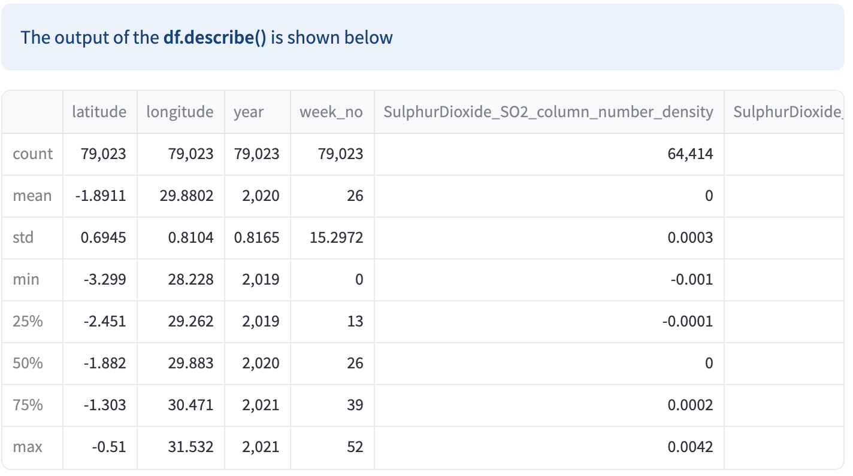
main · Streamlit (co2-emissions-in-rwanda.streamlit.app)
Project Significance

Slide 9
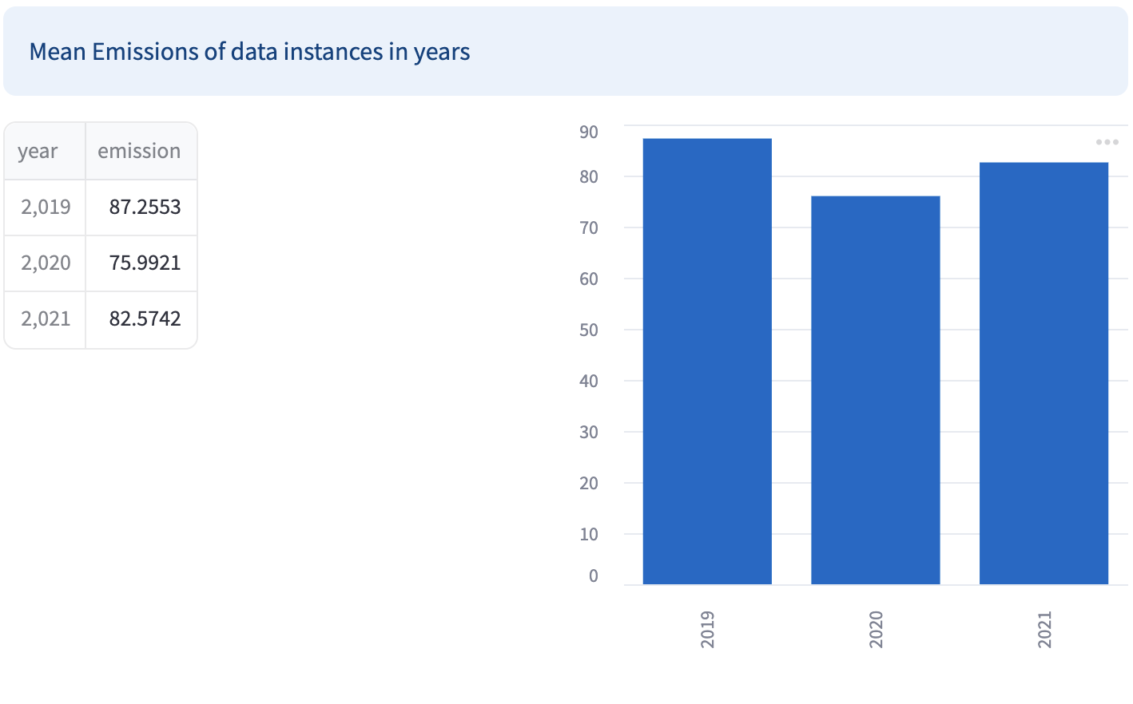
Yearly Emission Trend
main · Streamlit (co2-emissions-in-rwanda.streamlit.app)
Examination of yearly emissions reveals a correlation between the emission volume and the years. Notably, the analysis identifies 2020 as the year with the lowest emissions, a phenomenon attributed to the widespread impact of COVID-19. The decrease in human activities and the temporary shutdown of major factories during that year contributed to this notable decline in emissions.

Slide 10
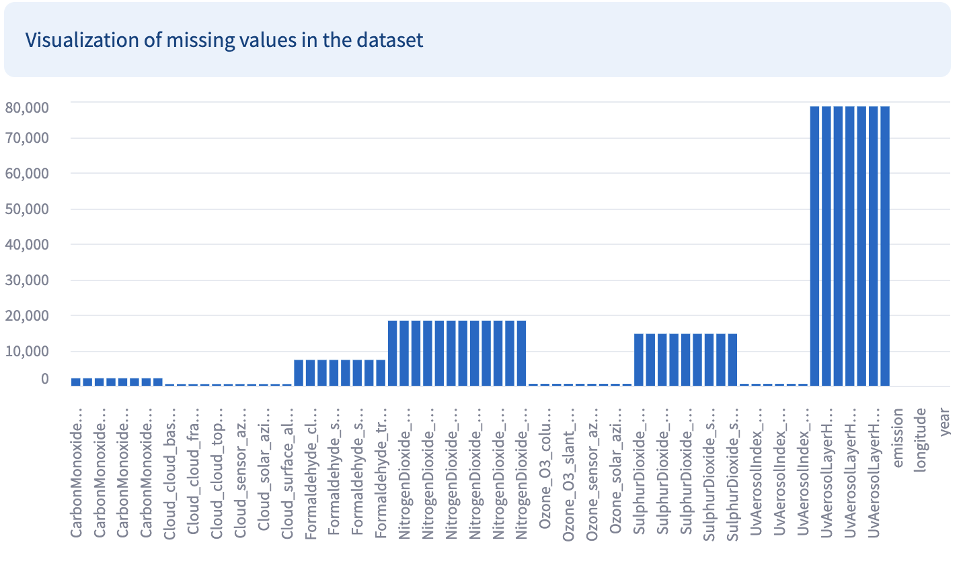
main · Streamlit (co2-emissions-in-rwanda.streamlit.app)
Feature Selection
Examine the features to analyze the percentage of missing values.
Rule of Thumb: Some practitioners use a rule of thumb, such as dropping features with more than 50%, 60%, or 70% missing values. In our case since we have about 75 columns, we decided to drop features with more than 40% missing values.
AWESOME SLIDE
Power Point Presentation

Slide 11
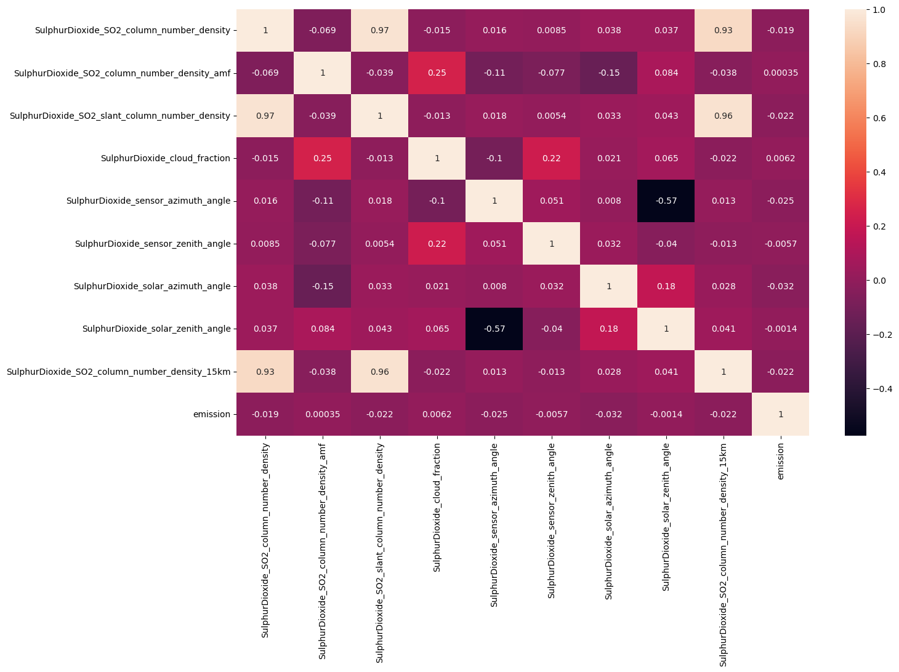
main · Streamlit (co2-emissions-in-rwanda.streamlit.app)
Sub Feature Selection
In the course of developing our machine learning model to predict emission levels, we delve into understanding the relationships between primary features and our target variable.
Each primary feature is meticulously dissected into various sub-features, offering a detailed perspective for thorough analysis. Our goal is to pinpoint a representative sub-feature within each primary feature category that exhibits the highest correlation with emission levels.
Employing heatmaps as a crucial analytical tool, these visual representations facilitate the identification of sub-features with the strongest correlations. Prioritizing these highly correlated sub-features enhances the predictive accuracy of our model, ensuring efficiency and effectiveness in forecasting emissions based on environmental factors. This strategy allows for a streamlined feature set, reducing complexity while potentially improving overall model performance

Slide 12
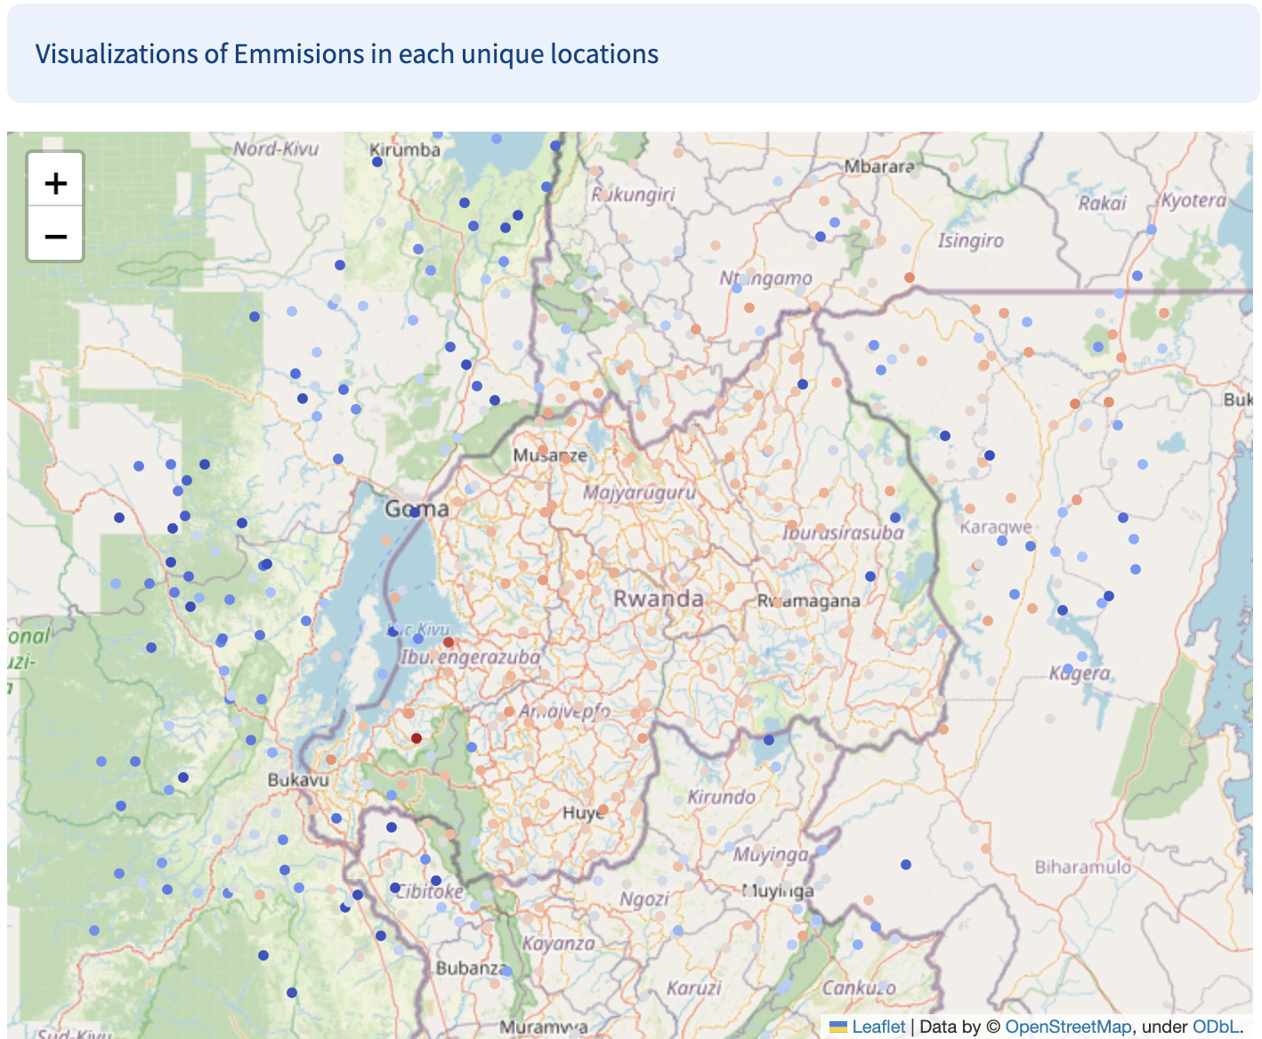
main · Streamlit (co2-emissions-in-rwanda.streamlit.app)
Missing Values : KNN Imputer
K-Nearest Neighbors (k-NN) Imputation:
Method: In k-NN imputation, missing values are imputed based on the values of their k-nearest neighbors in the feature space.
Pros:
Utilizes information from similar data points, making it more sophisticated than mean or median imputation.
Preserves the relationships between features.
Suitable for datasets where missing values are not missing completely at random.

Slide 13
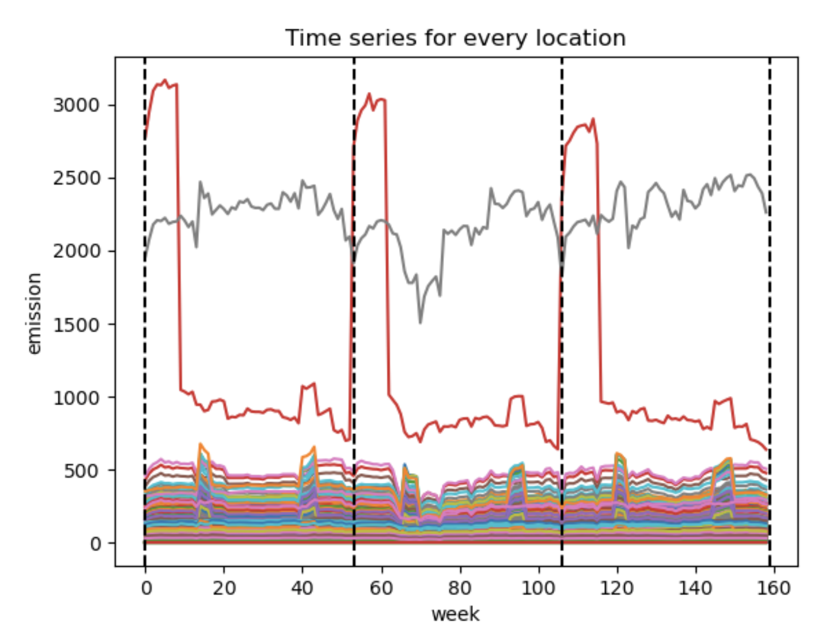
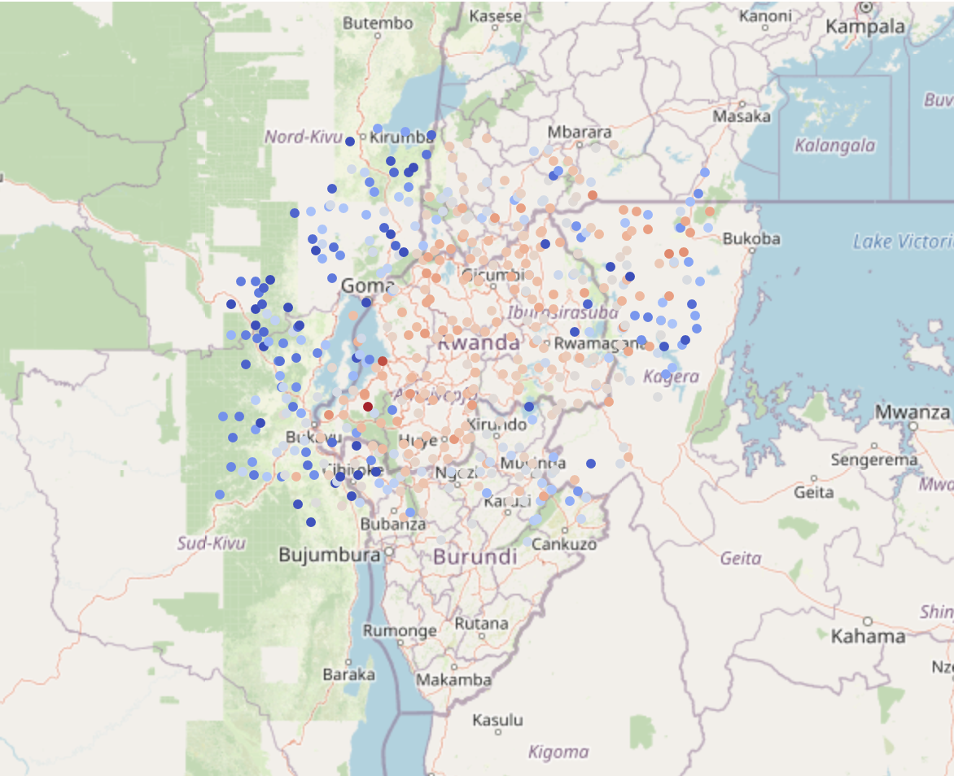
main · Streamlit (co2-emissions-in-rwanda.streamlit.app)
Time-series Approach
In the process of refining our dataset for analysis, we deliberately opted to retain only the columns related to latitude, longitude, and week number. This strategic decision was heavily influenced by the valuable insights shared by a domain expert in environmental science, currently pursuing a master's degree. According to their expert knowledge, emissions exhibit intricate connections to time-series variations. This insight prompted us to concentrate on the spatial and temporal aspects of our data. By incorporating latitude and longitude, we ensure that our analysis encompasses the geographic distribution of emissions, acknowledging the significant variability in environmental impacts across different locations. The inclusion of the week number is equally pivotal, enabling us to investigate the temporal fluctuations in emissions from week 0 to week 52. This temporal dimension is crucial for comprehending seasonal patterns, trends, and anomalies in emission levels. Focusing specifically on these columns tailors our analysis to explore the intricate relationship between emissions and their temporal and spatial dynamics, aligning seamlessly with the specialized expertise provided by the environmental science expert.

Slide 14
MODEL EVALUATION
main · Streamlit (co2-emissions-in-rwanda.streamlit.app)
TESTING AND COMPARISON

Slide 15
main · Streamlit (co2-emissions-in-rwanda.streamlit.app)
Model Comparison
MODEL | R2 SCORE | MSE | RMSE
RANDOM FOREST | 96.7 | 670.4 | 25.9
DECISION TREE | 95.6 | 899.1 | 30.0
GRADIENT BOOST | 81.7 | 3807.5 | 61.7
KERNEL RIDGE | 1.06 | 16925.0 | 130.0
LINEAR REGRESSOR | 0.09 | 20572.6 | 140.4
LASSO | 0.09 | 20572.0 | 143.4

Slide 16
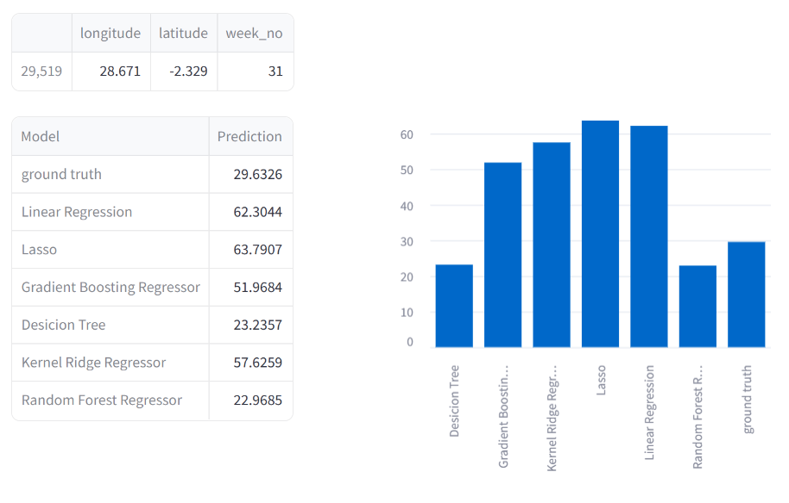
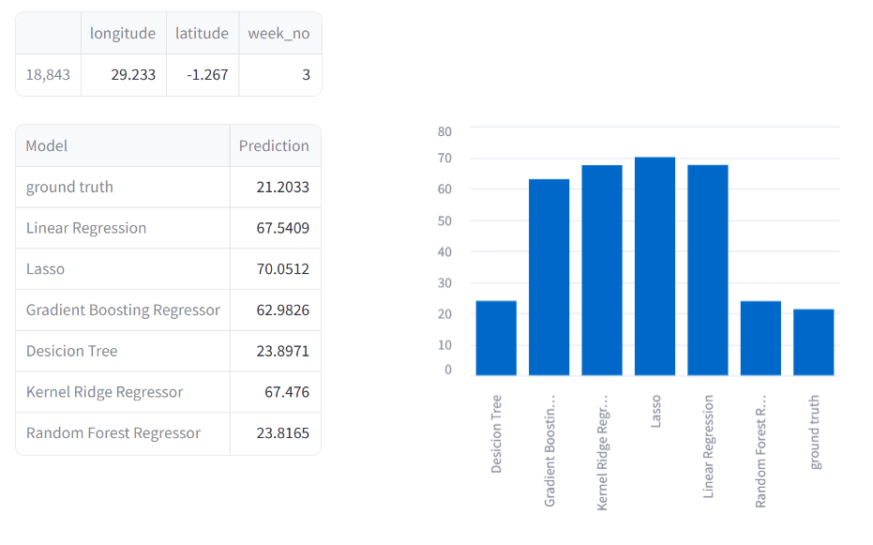
MODEL PREDICTION
main · Streamlit (co2-emissions-in-rwanda.streamlit.app)

Slide 17
main · Streamlit (co2-emissions-in-rwanda.streamlit.app)
Project Conclusion
In our study to predict CO2 emissions in Rwanda, we employed two distinct modeling approaches. The first method integrated a range of air pollutants as features alongside spatial and temporal data, hypothesizing that correlations between these pollutants and CO2 emissions would be indicative of overall emission levels. The second method relied exclusively on time-series data, capitalizing on the temporal patterns in emission levels without considering additional pollutant data.
The results were clear: the time-series approach yielded superior predictions. This suggests that, in the Rwandan context, temporal dynamics play a more significant role than the interplay between various air pollutants when it comes to forecasting CO2 emissions. The strength of the time-series model may lie in its capacity to capture patterns and trends over time, which appear to be highly predictive of emission levels.
Further analysis of model performance revealed that tree-based methods, specifically the Decision Tree Regressor and the Random Forest algorithm, were particularly effective on this dataset. These methods are known for their ability to handle non-linear relationships and complex interactions between features, which likely contributed to their success in capturing the nuances of the emission data.
On the other hand, the Linear Regression model did not perform as well. This was indicative of the data's non-linear nature, which Linear Regression, with its assumption of linearity, could not adequately capture. The failure of this model underscores the importance of selecting a model that aligns with the underlying data structure.
In conclusion, when predicting CO2 emissions in Rwanda, a time-series analysis provides a robust framework, especially when employing tree-based models that excel in deciphering the intricate patterns present in such environmental data. These findings can guide future efforts in environmental modeling and help policymakers in Rwanda and similar contexts to better understand and predict CO2 emissions, leading to more informed and effective environmental strategies.

Slide 18
main · Streamlit (co2-emissions-in-rwanda.streamlit.app)
Future Work
Due to the limited availability of data, we couldn't consider 2020 as an outlier, which could improve the model.
Secondly, Integrating weather-related features such as temperature, humidity, wind speed, and atmospheric pressure, as these factors significantly impact emissions.
Furthermore, we can explore advanced modelling techniques especially neural networks that capture complex relationships in data. Some examples are Recurrent Neural Networks (RNNs) and Long Short-Term Memory (LSTM) networks are suitable for time series data.

Slide 19
Thank You
main · Streamlit (co2-emissions-in-rwanda.streamlit.app)
Prediction CO² prediction in Rwanda

